Slide 1
Library Management System
By Md.Rafiul Alam Durjoy

Slide 2
Table Of Contents
Project Name.
Advantage Of LMS.
Aim Of Project.
Tools Used.
Feature.
Types Of User.
UI Design.
Scope.

Slide 3
What is Library Management System?
Library Management System is a project which aims in developing a computer system to maintain all the daily work of library.

Slide 4
Advantages Of LMS
Record maintenance.
Web-Based Solution.
Saves Time and Cost.
Secure and Reliable.
Simple and Easy to Use.

Slide 5
Aim of Project
The aim of the project is to keep track of all books. It’ll keep the information of the books such as, who are taking the books how many books are issued, books are available or not, due calculation etc.
So,it will be more easy to know about any books and others information for everyone.

Slide 6
Tools Used
HTML
CSS
PHP
DATABASE- MYSQL

Slide 7
Feature
User Login.
Register New User.
Book-Issue.
Search Book.
Return-Book.
Overdue calculation.
User Management.

Slide 8
Types of Users
Admin Login
Student Login

Slide 9
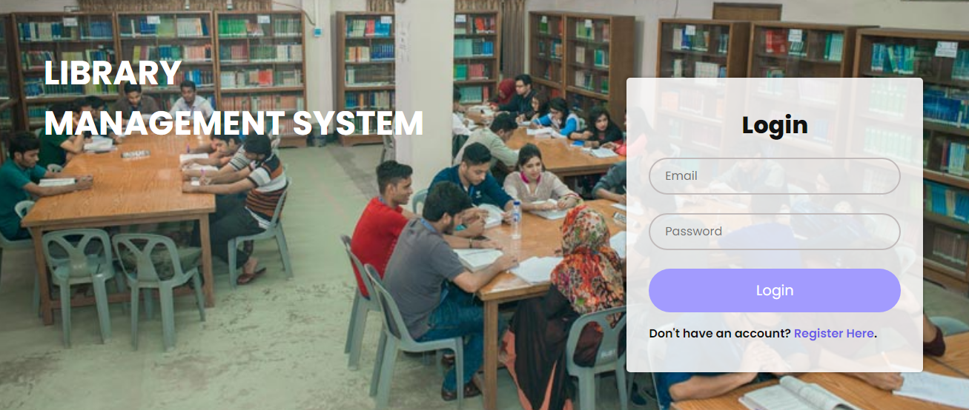
Project Design

Slide 10
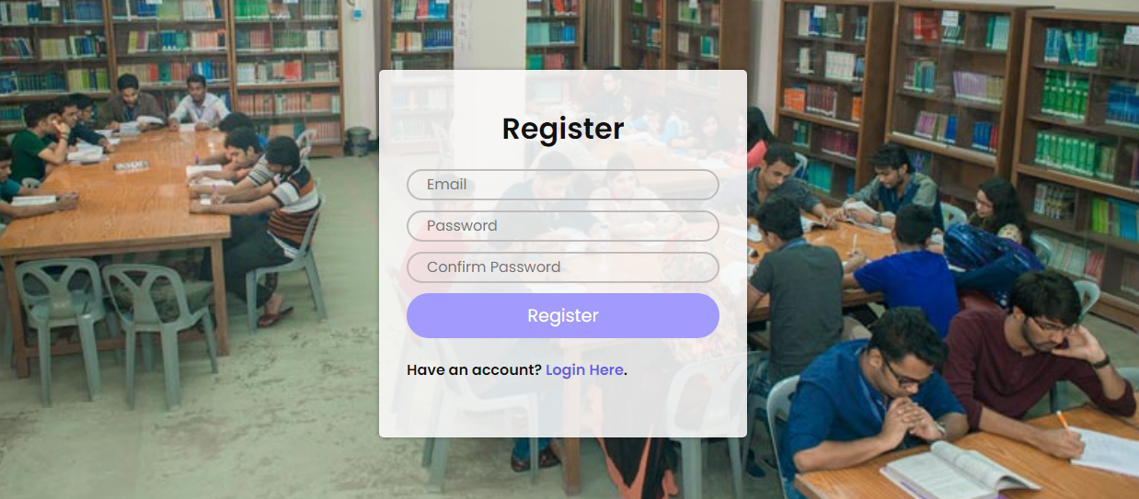
Project Design

Slide 11
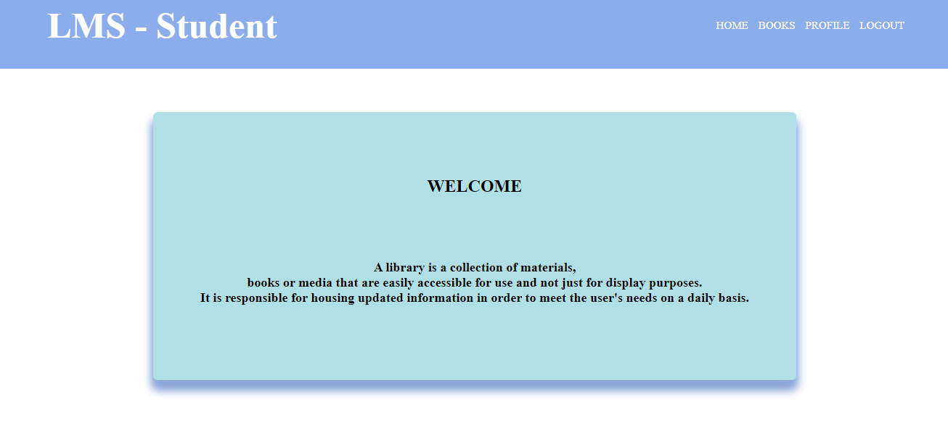
Project Design

Slide 12
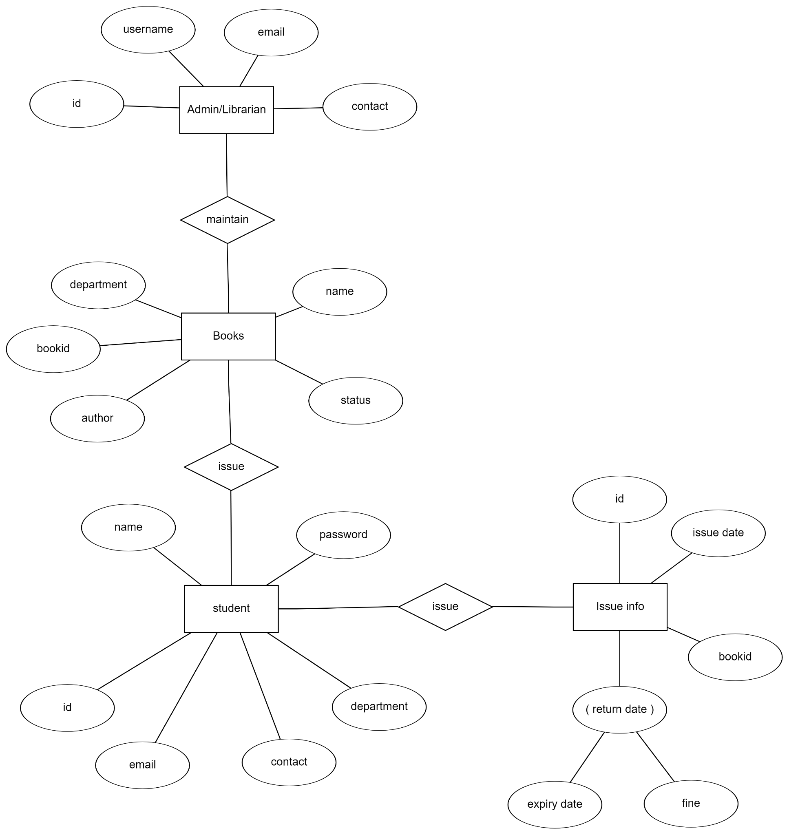
ER-Diagram

Slide 13
Scope
There is some future scope for this so that it can be used many institutions like,
Education Institute.
Government and Private Offices.
E-Book Facility.

Slide 14
Thanks

